Slide 1
Computer Vision Car license plate recognition
Emanuele Corongiu

Slide 2
Summary
Problem configuration
Possible solution
Yolo V8
Input Data
Training and result
Tracking

Slide 3
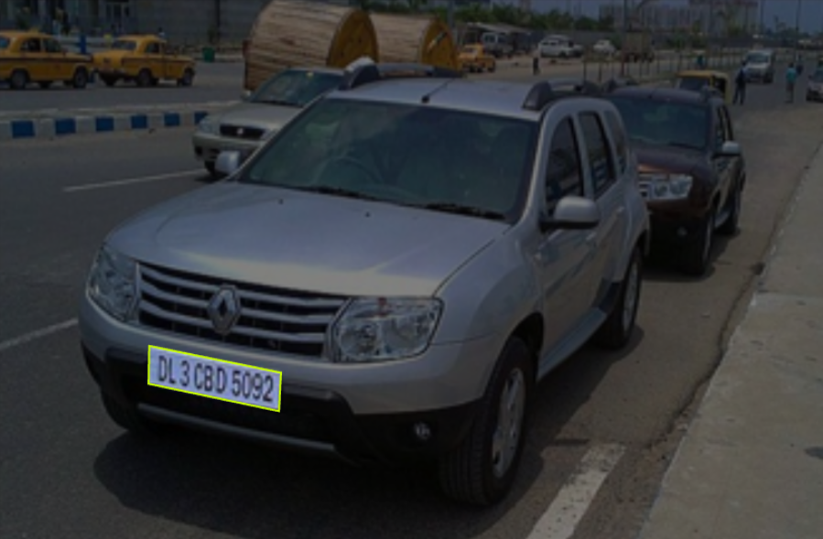
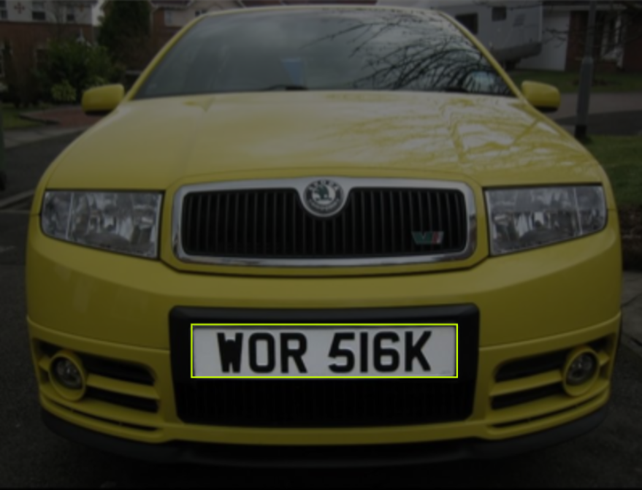
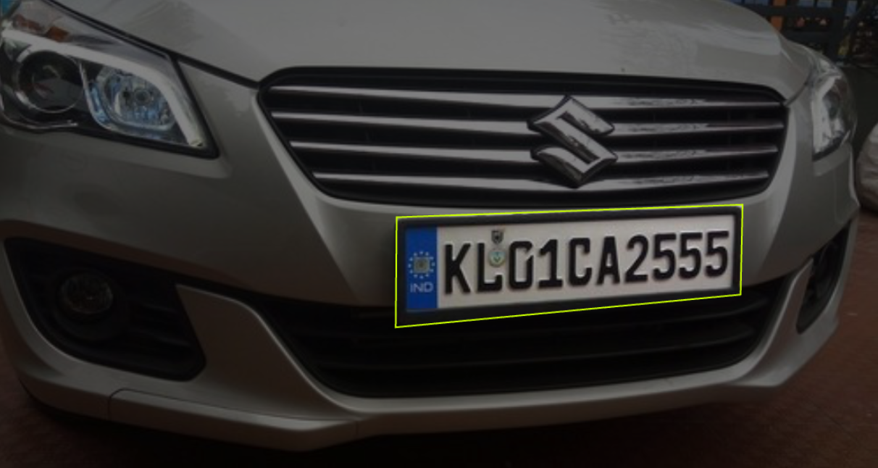
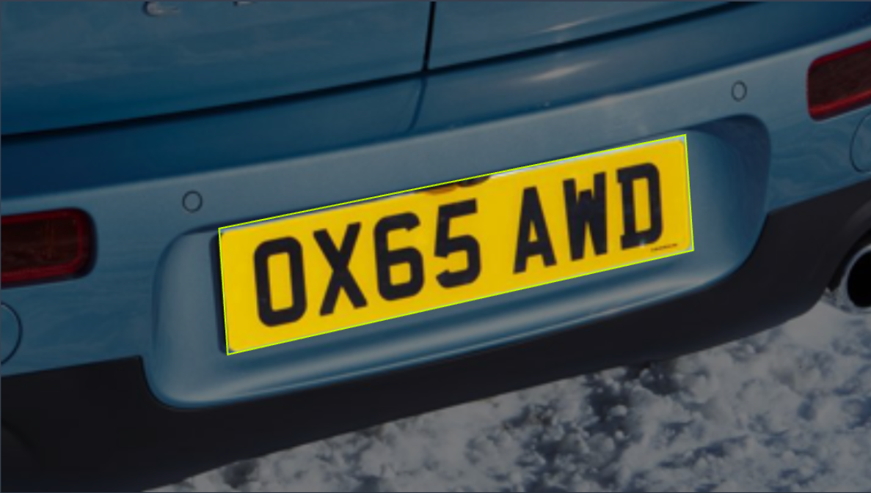
Problem Configuration
Images source: How to Use the carPlate Object Detection API (roboflow.com)

Slide 4
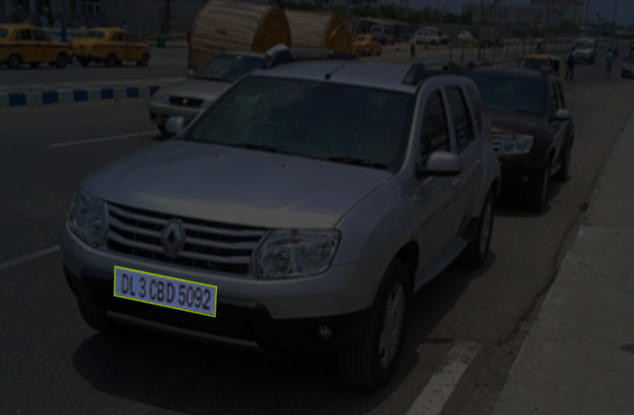
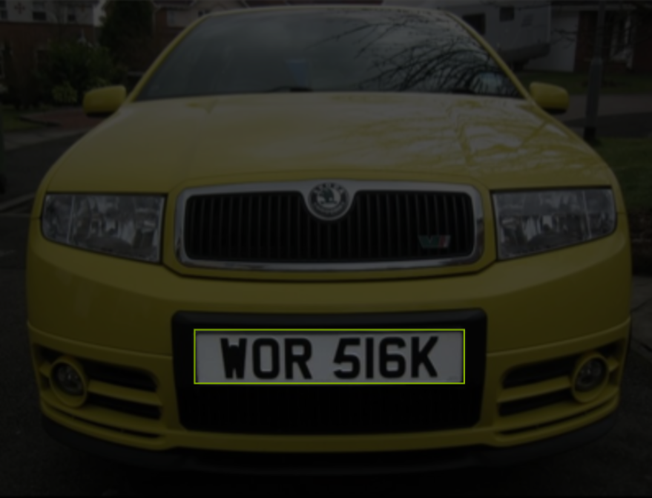
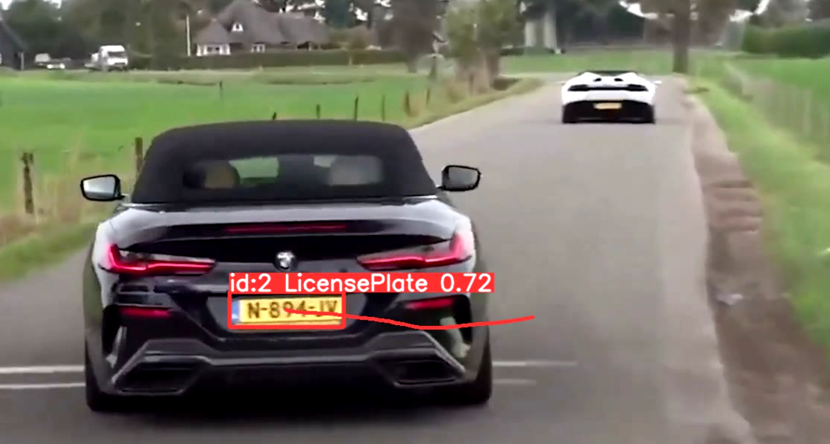
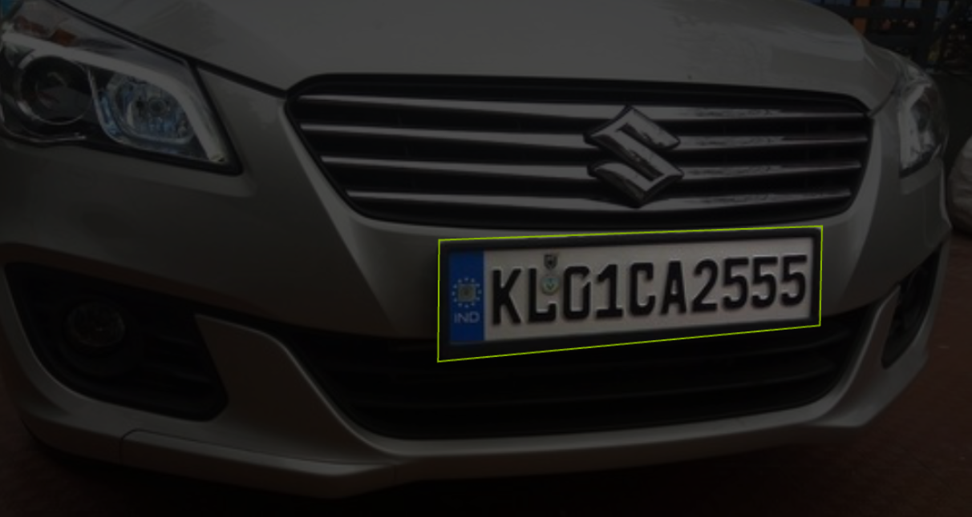
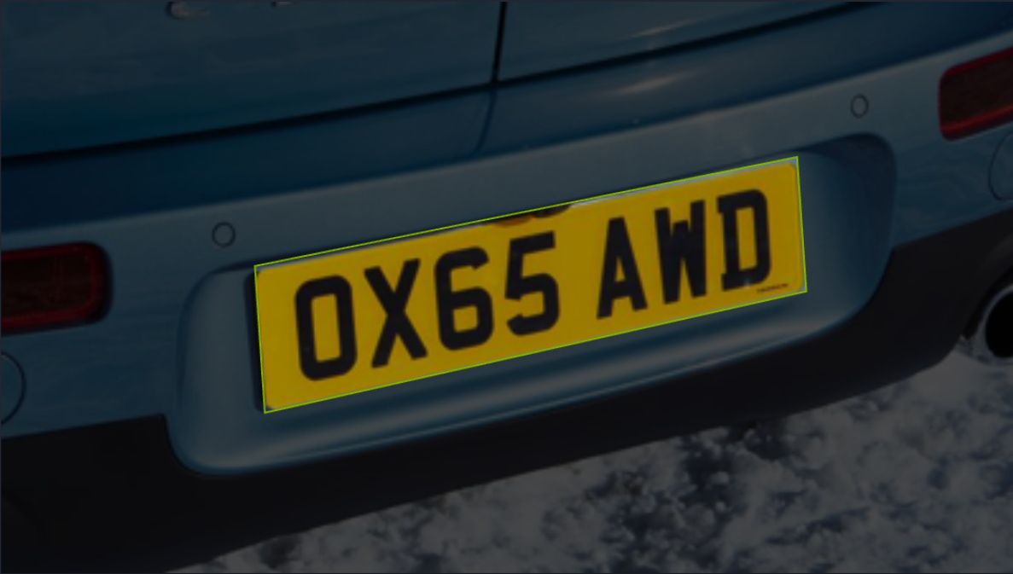
Problem Configuration
Images source: How to Use the carPlate Object Detection API (roboflow.com) https://github.com/Arijit1080/Licence-Plate-Detection-using-YOLO-V8

Slide 5
Possible solutions
Classic Image processing techniques
Machine learning techniques
Images source: How to Use the carPlate Object Detection API (roboflow.com) https://github.com/Arijit1080/Licence-Plate-Detection-using-YOLO-V8

Slide 6

Possible solutions
Classic Image processing techniques
Machine learning techniques
As exaplample is CV library
Yolo V8
Images source: How to Use the carPlate Object Detection API (roboflow.com) https://github.com/Arijit1080/Licence-Plate-Detection-using-YOLO-V8

Slide 7
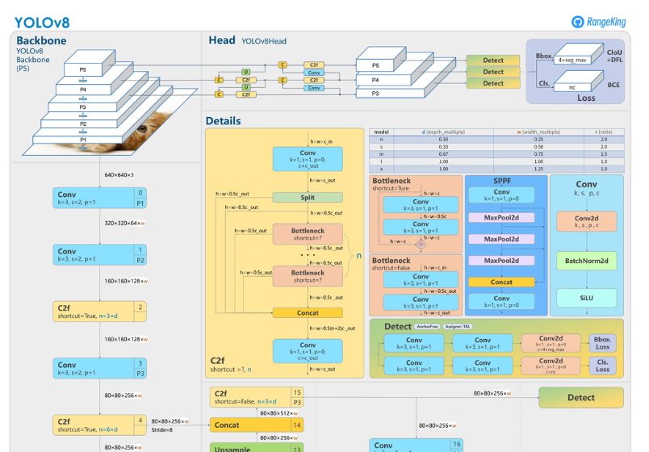
Yolo V8
Is based on machine learning techniques and allows to perform many operations such as detection and tracking.
Image source: What is YOLOv8? The Ultimate Guide. (roboflow.com)

Slide 8

Yolo V8
DETECTION!
Image with car license plate
YOLO V8
or
TRACKING!

Slide 9
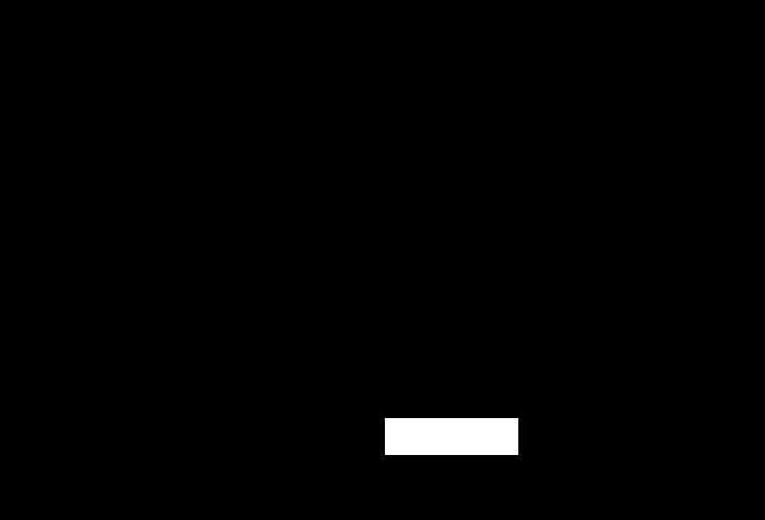
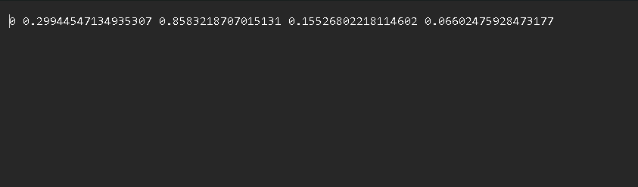
Input data
Data input to the model can be given in different ways, such as through binary masks or through a text file.
In some cases, therefore, the pre-processing phase before training can be a challenge.
Images source: How to Use the carPlate Object Detection API (roboflow.com) https://github.com/Arijit1080/Licence-Plate-Detection-using-YOLO-V8

Slide 10
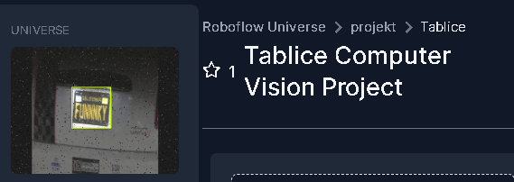
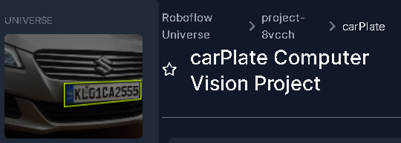
Input data
Images source: How to Use the carPlate Object Detection API (roboflow.com) https://github.com/Arijit1080/Licence-Plate-Detection-using-YOLO-V8
Tablice Dataset (roboflow.com)
carPlate Dataset (roboflow.com)

Slide 11
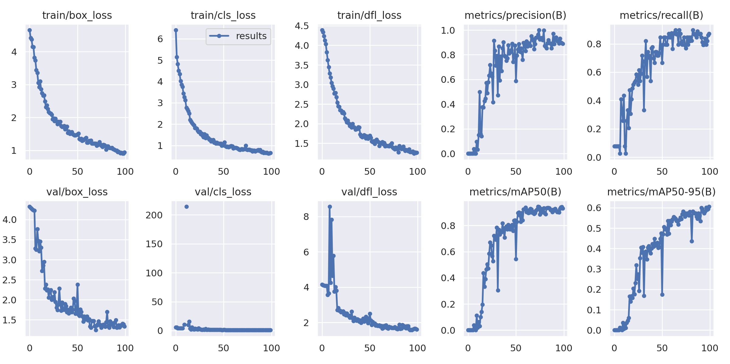
Training and results
With the small dataset: about 300 images in total

Slide 12
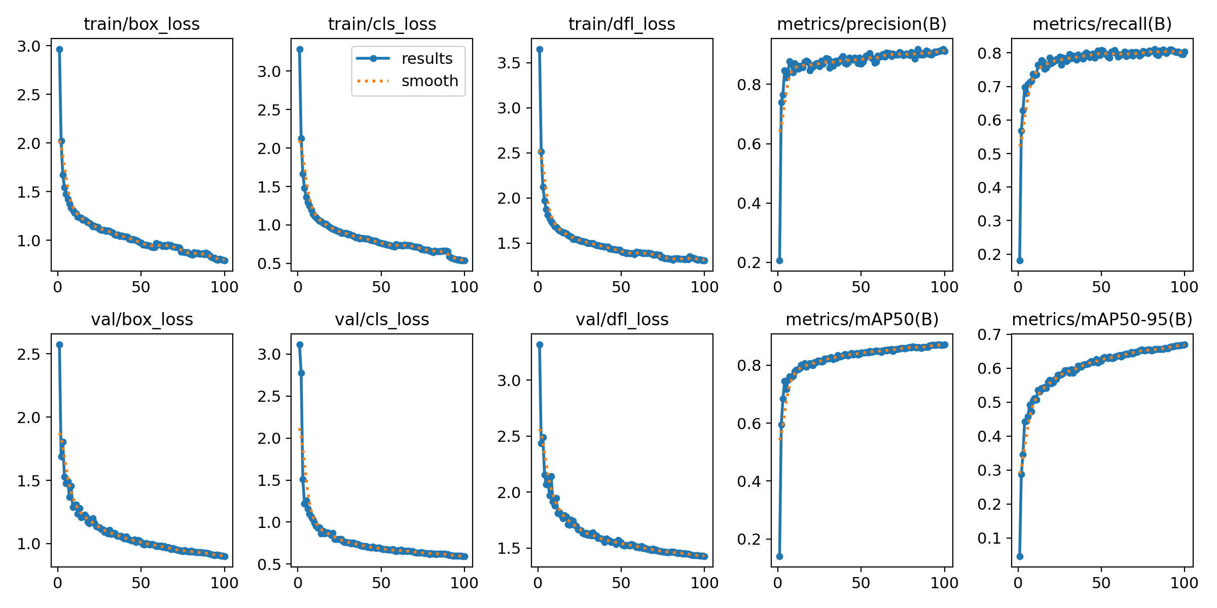
Training and results
With the big dataset: about 8000 images in total

Slide 13
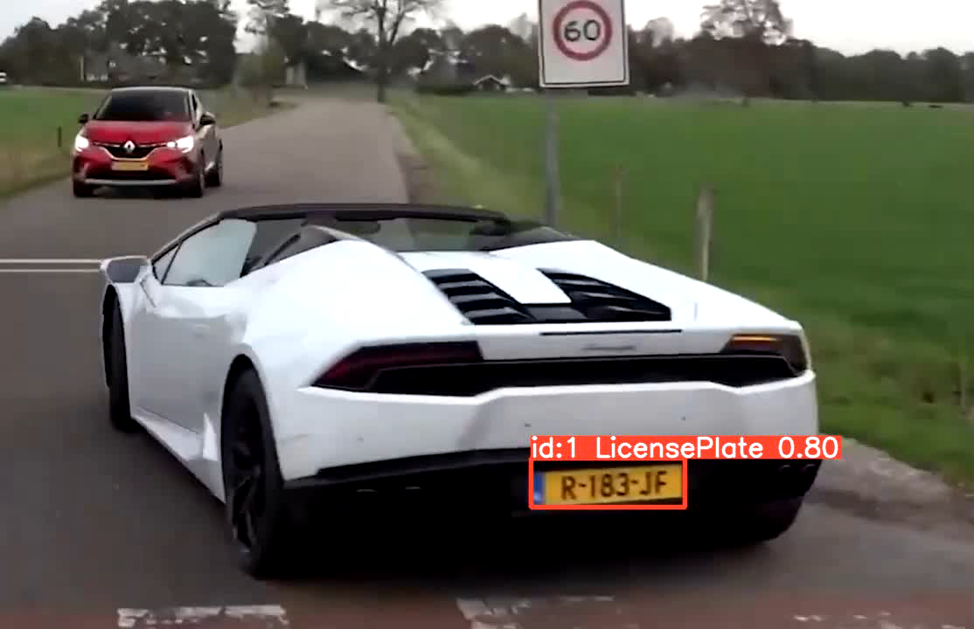
Tracking
The ouput of YOLO in tracking mode
Video demo source: https://github.com/Arijit1080/Licence-Plate-Detection-using-YOLO-V8

Slide 14
Thanks for the attention

